Slide 1

Independent Study Update: MMTN Week 6
Karthik 2021.11.18
AMLL

Slide 2
Overview
Disclaimer – major bug, solved 2 hours before meeting, following data is based on 3 trials of k=[1,2,3,4] with a small repulsion term (lambda = 0.02, sigma squared = 0.04)
Your suggestions on last week’s update
k inverse models

Slide 3
Geometry Exploration
Log vs sqrt color scale – color makes much more sense here

Slide 4
Geometry Exploration
Per Ben’s suggestion, multiply weight of boundary in error by 100 – solved issues with [-1, 1] domain

Slide 5
Geometry Exploration
In areas of overlap different manifolds seem kind of similar but not exactly the same

Slide 6
Geometry Exploration
Errors with expected y values
Individual errors on next slide
Too dense to gather anything

Slide 7
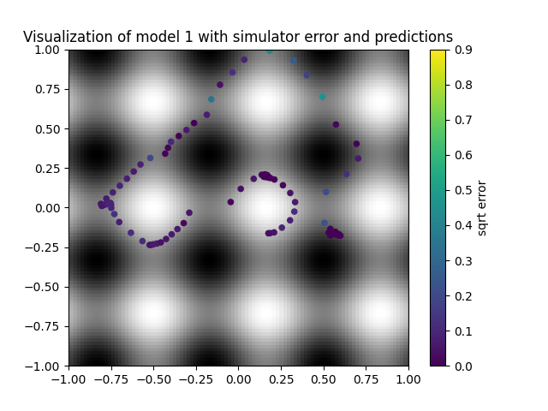
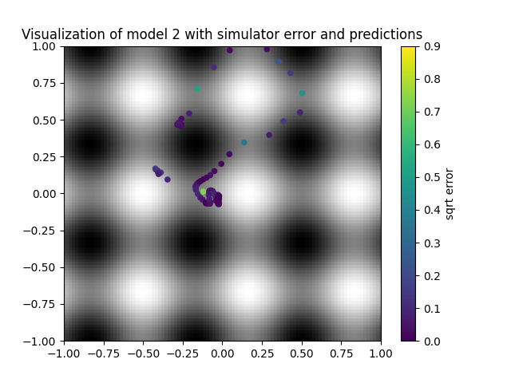

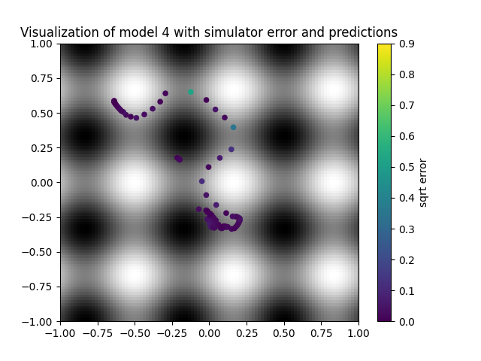
Geometry Exploration

Slide 8
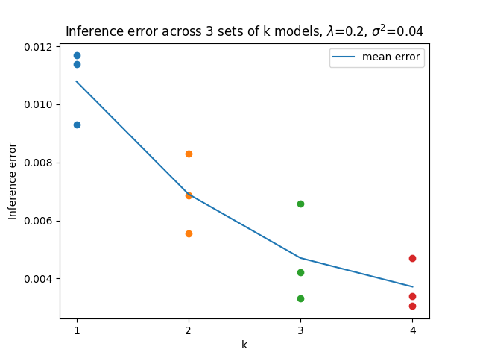
Multiple values of k
3 trials for k = 1, 2, 3, 4 inverse models
Mean error clearly goes down in exactly expected pattern – diminishing return
Much less noisy than before, but also need more trials
Error in title: lambda = 0.02, not 0.2

Slide 9
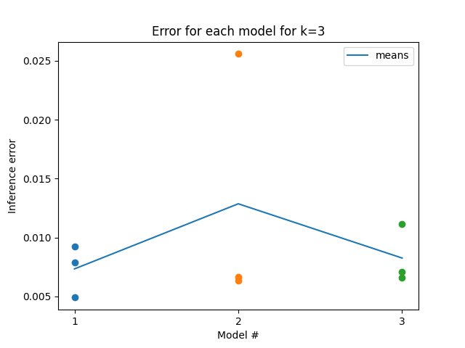
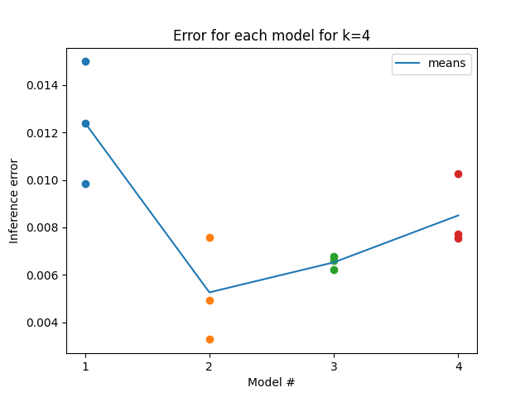
Multiple values of k
Was curious to see if each subsequent model’s inference error in a given set was increasing due to being pushed away from existing models
Doesn’t appear to be the case – seems like a good thing?

Slide 10
Next steps
Step 1a: Rerun graph on slides 8 and 9 with more trials and compare selection by simulator to selection by min forward error
Step 1b: set lambda = 0, run on other datasets and confirm error drops as k increases
Step 2: Generating ys for the backward models rather than training on dataset
Step 3: re-confirm that repulsion term performs better than lambda = 0

